Slide 1

Import Export Concept
Made By : Kaustubh S. Wade
Enroll. No. : 160410116050
Guided By : Prof Disha Patel

Slide 2


Definition
Import : the term import is derived from the conceptual meaning as to bring in the goods and services in the port of a country. The buyer of such goods and services is referred to an importer.
Export : the term export is derived from the conceptual meaning as to ship the goods and services out of the port of a country. The seller of such goods and services is referred to as an exporter.

Slide 3
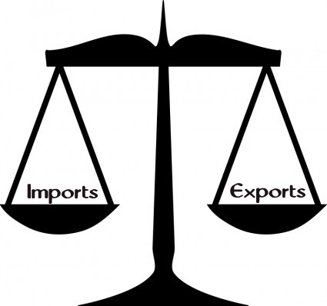
Balance of trade
Balance of trade represents a difference in value for import and export for a country.
A trade deficit occurs when imports are large relative to exports.
Imports are impacted principally by a country’s income and its productive resources.

Slide 4

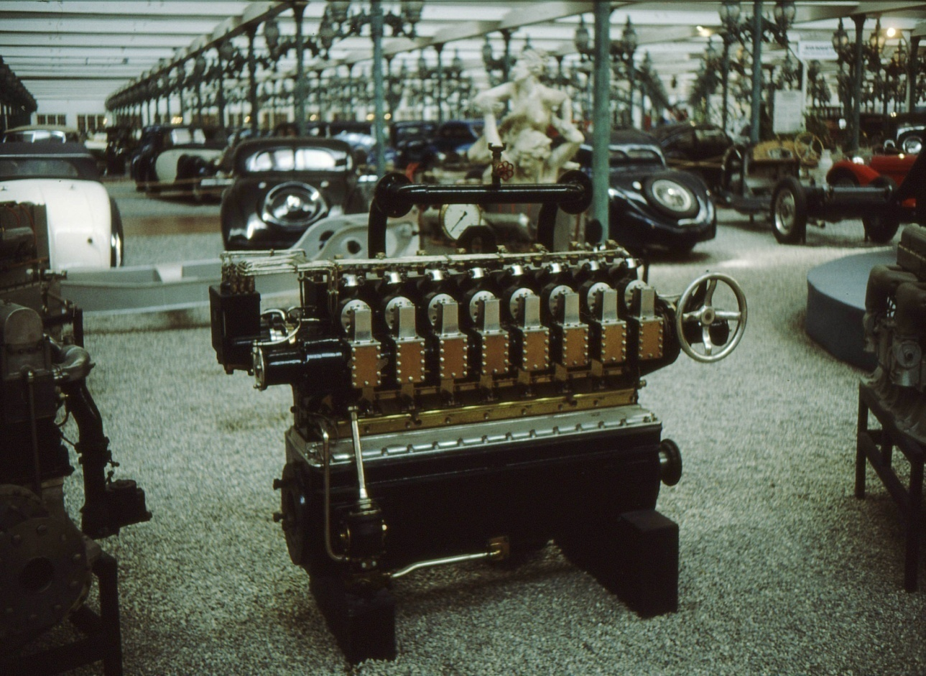
Types of Import
Industrial and Consumer goods.
Appliances, Refrigerators, Food and Beverages, Gasoline and Clothes, Computers etc.
Intermediate goods and services.
Steel, which can be used in the construction of a house or in the production of cars; Wood, used to make flooring and furniture; Glass, used in the production of windows and eyeglasses

Slide 5

Types of Export
Physical/Visible Export : if goods physically go out of the country.
Oil, Machinery, Food and Clothes.
Deemed/Invisible Export : If goods and services are supplied to another entity.
Insurance, Banking, Tourism and Education.

Slide 6
Import Export Process
REGISTER AS AN IMPORTER OR EXPORTER
NEGOTIATE TERMS OF SALE
UNDERSTAND EXPORT FORMALITIES AND RESPONSIBILITY TOWARDS SALE PROCEEDS
UNDERSTAND DOCUMENTATION AND INCOTERMS
FOR EXPORT,COMPLETE CUSTOMS FORMALITIES AND OBTAIN DOCUMENTS
RECEIVE SALE PROCEEDS
SUBMIT TO THE BANK FOR ONWARD TRANSMISSION TO BUYER

Slide 7

Advantages of Import
Reduce Dependence on existing markets.
Exploit international trade technology.
Extend sales potential of existing products.
Maintain cost competitiveness in your domestic market.

Slide 8

Disadvantages of Import
Importation of items from other countries can increase the risk of getting them which is no more common in the warm weather.
It leads to excessive competition
It also increases risks of other diseases from which the country is exporting the goods.

Slide 9
Advantages of Export
Exporting is one way of increasing your sales potential
Increasing sale and profit
Reduce risk and balancing growth
Sell excess production capacity
Gain new knowledge and experience

Slide 10
Disadvantage of Export
Extra costs
Financial risk
Export licences and documentation
Market information

Slide 11
GDP and IMPORT-EXPORT
When a country exports goods, it sells them to a foreign market, that is, to consumers, businesses, or governments in another country. Those exports bring money into the country, which increases the exporting nation's GDP.
When a country imports goods, it buys them from foreign producers. The money spent on imports leaves the economy, and that decreases the importing nation's GDP.

Slide 12
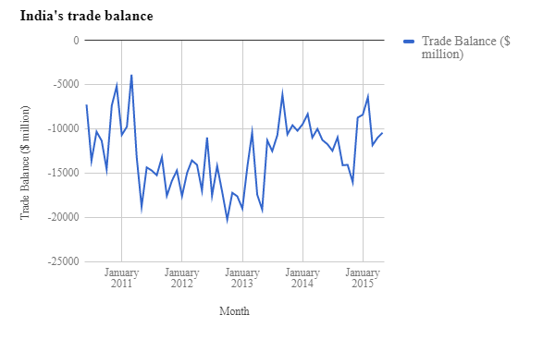

Slide 13
Case Study
Non Resident Importer Case Study

Slide 14
Challenge
A US vendor planned to distribute their product directly to Canadian outdoor and sporting goods retail stores. To be successful it was imperative that it was easy and transparent for the Canadian retailer to purchase the goods direct and not have to deal with price uncertainties and border related issues.

Slide 15
Solution
By consulting with the A & A Non-Resident specialists, the US vendor was established as a Non-Resident Importer with a program customized to meet the vendor’s specific goals for the market.

Slide 16
Results
• Accurate “delivered” price provided at time of sale. • A transparent border transaction for the Canadian retail customer. • Uniform pricing – no variables on delivery or clearance. • Savings on customs clearance fees. • Improved delivery times. • Improved inventory control. • Enhanced customer service. • Increased sales and Canadian market share

